Slide 2
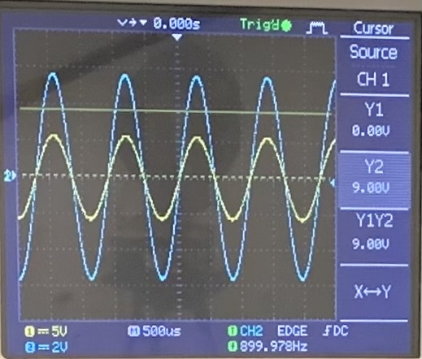
Problem Statement
The responses of a LRC circuit driven by an AC source can be changed by inserting either a non-magnetic metal rod or a ferromagnetic rod into the inductor coil. How can we obtain the magnetic and electric properties of the inserted rod from the circuit’s responses?

Slide 3
I. LRC

Slide 4
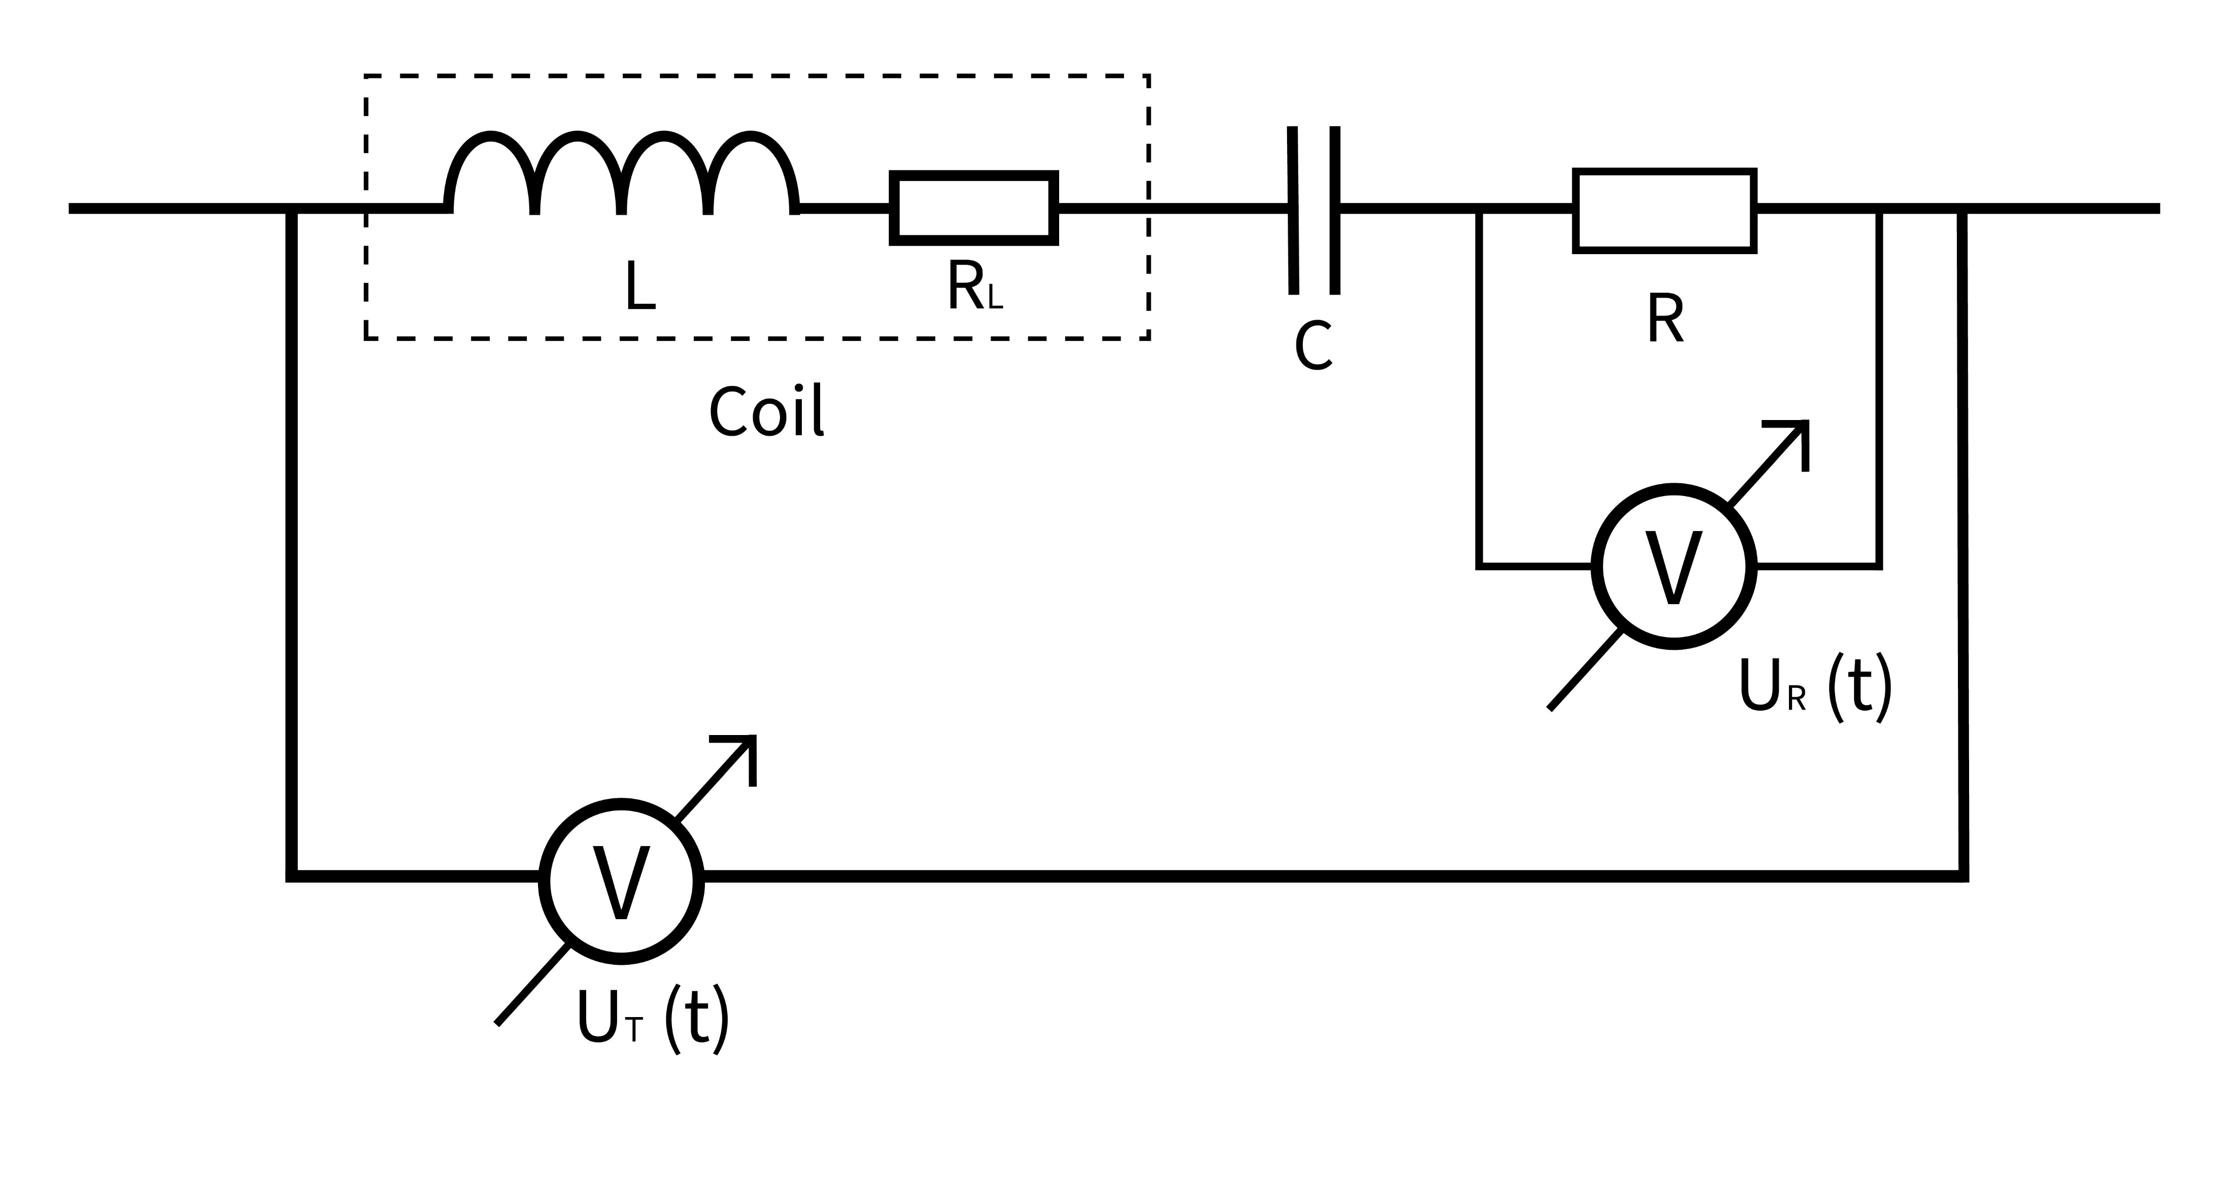
The circuit

Slide 5
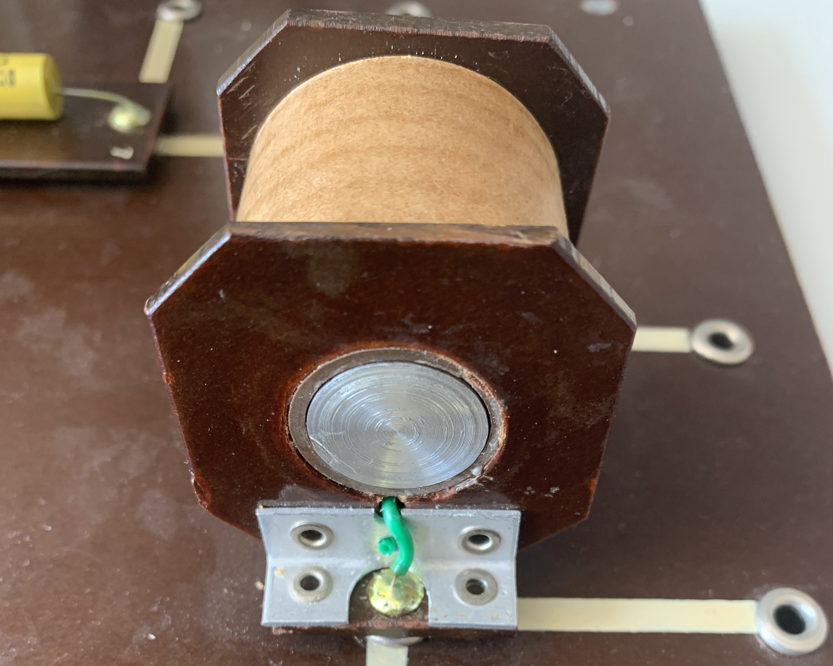
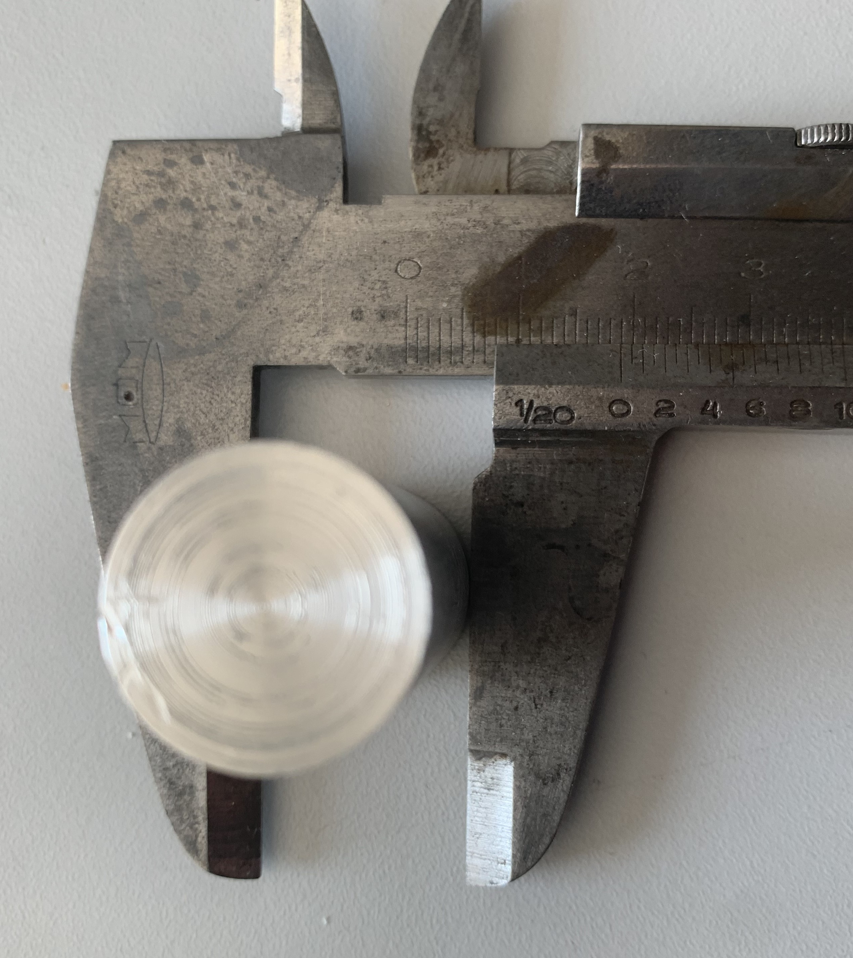
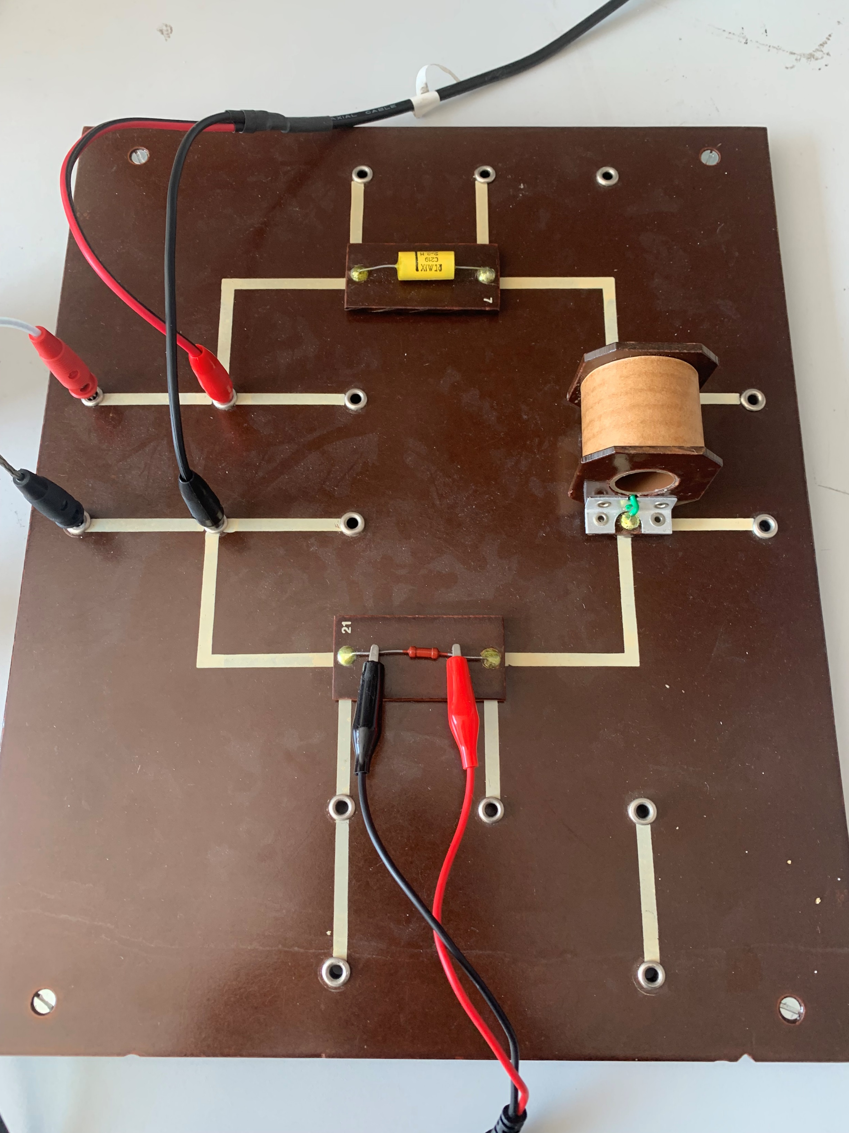
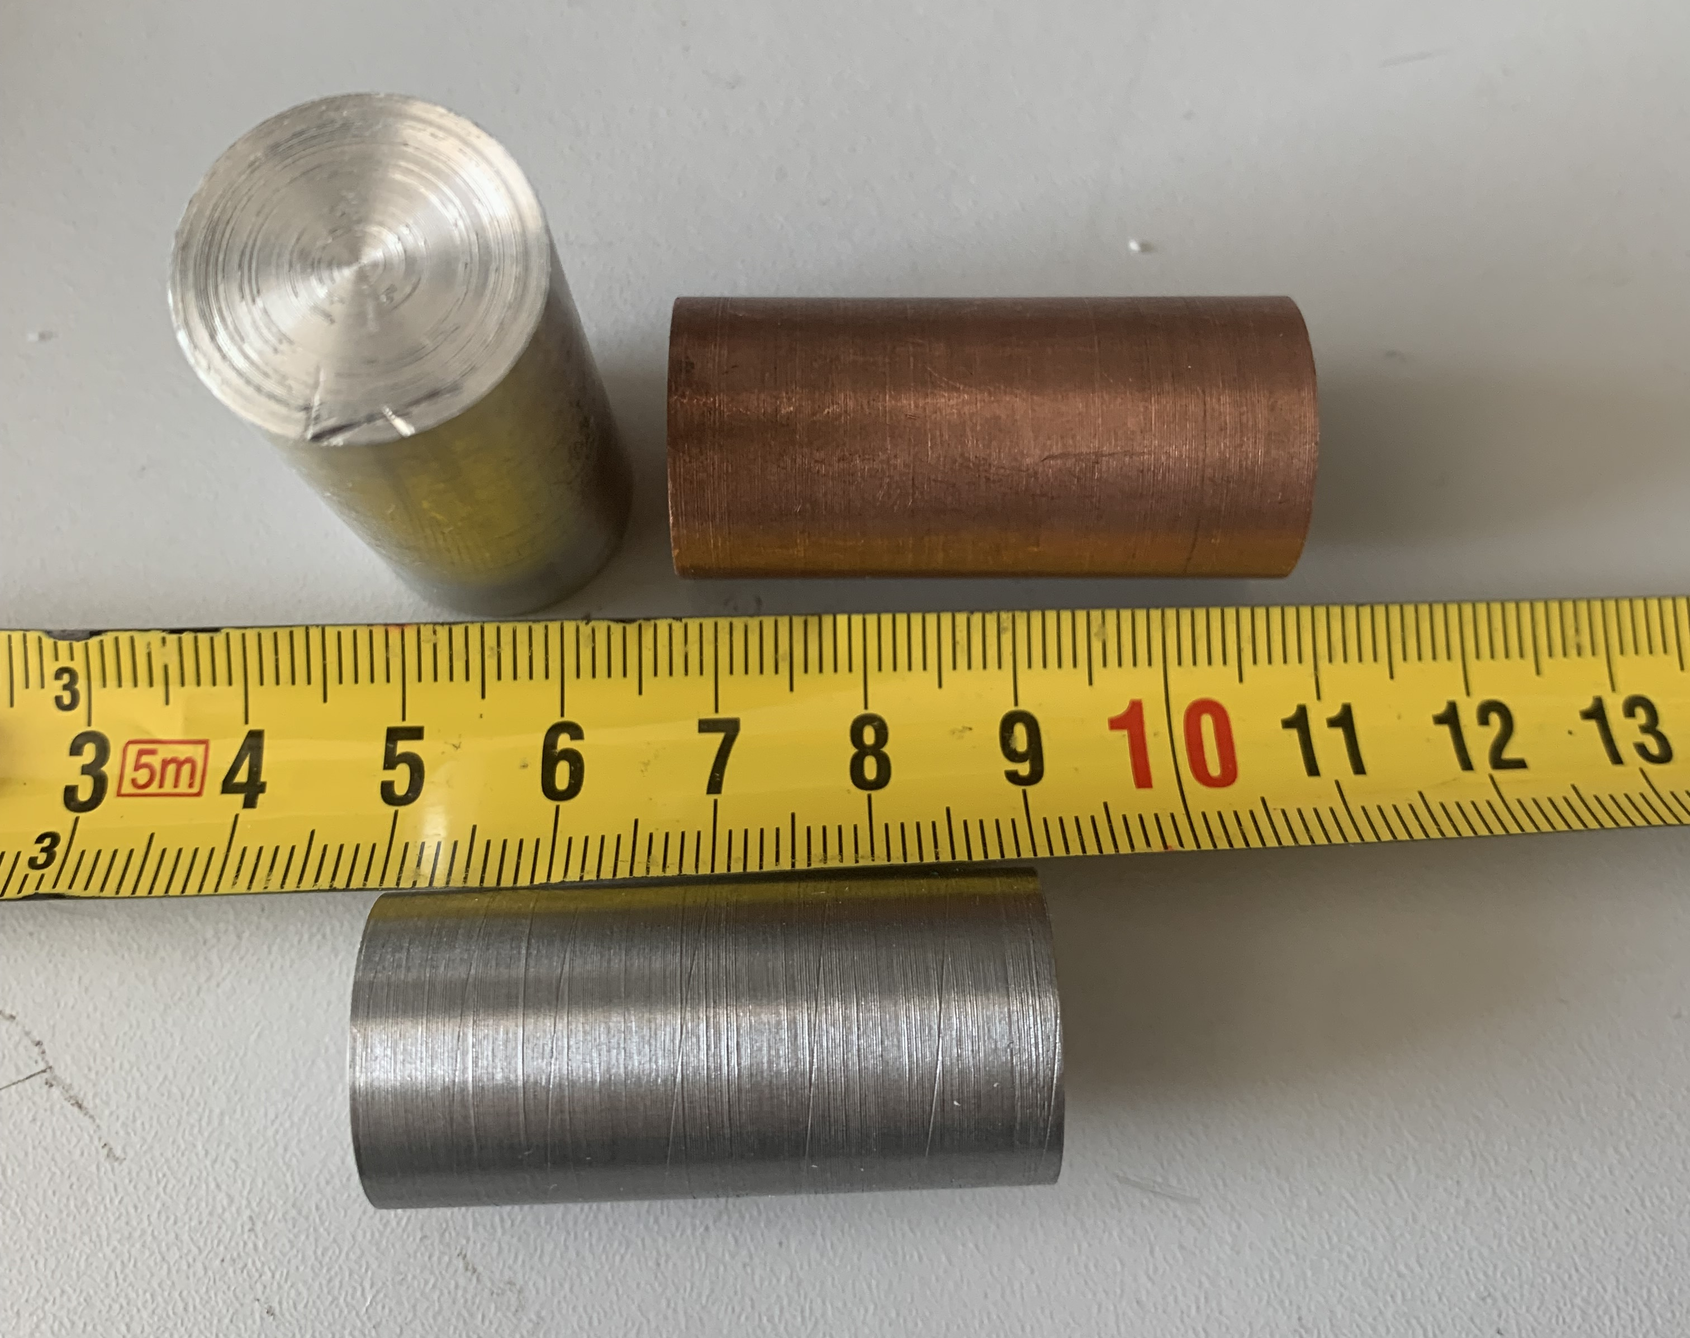
Setup
Coil:
N = 1200
L = 0.02H
R = 15Ω
l = 5cm
d = 1.9cm
C = 2.2μF
R = 1035Ω
Materials:
Aluminum (Al)
Copper (Cu)
Iron (Fe)

Slide 6
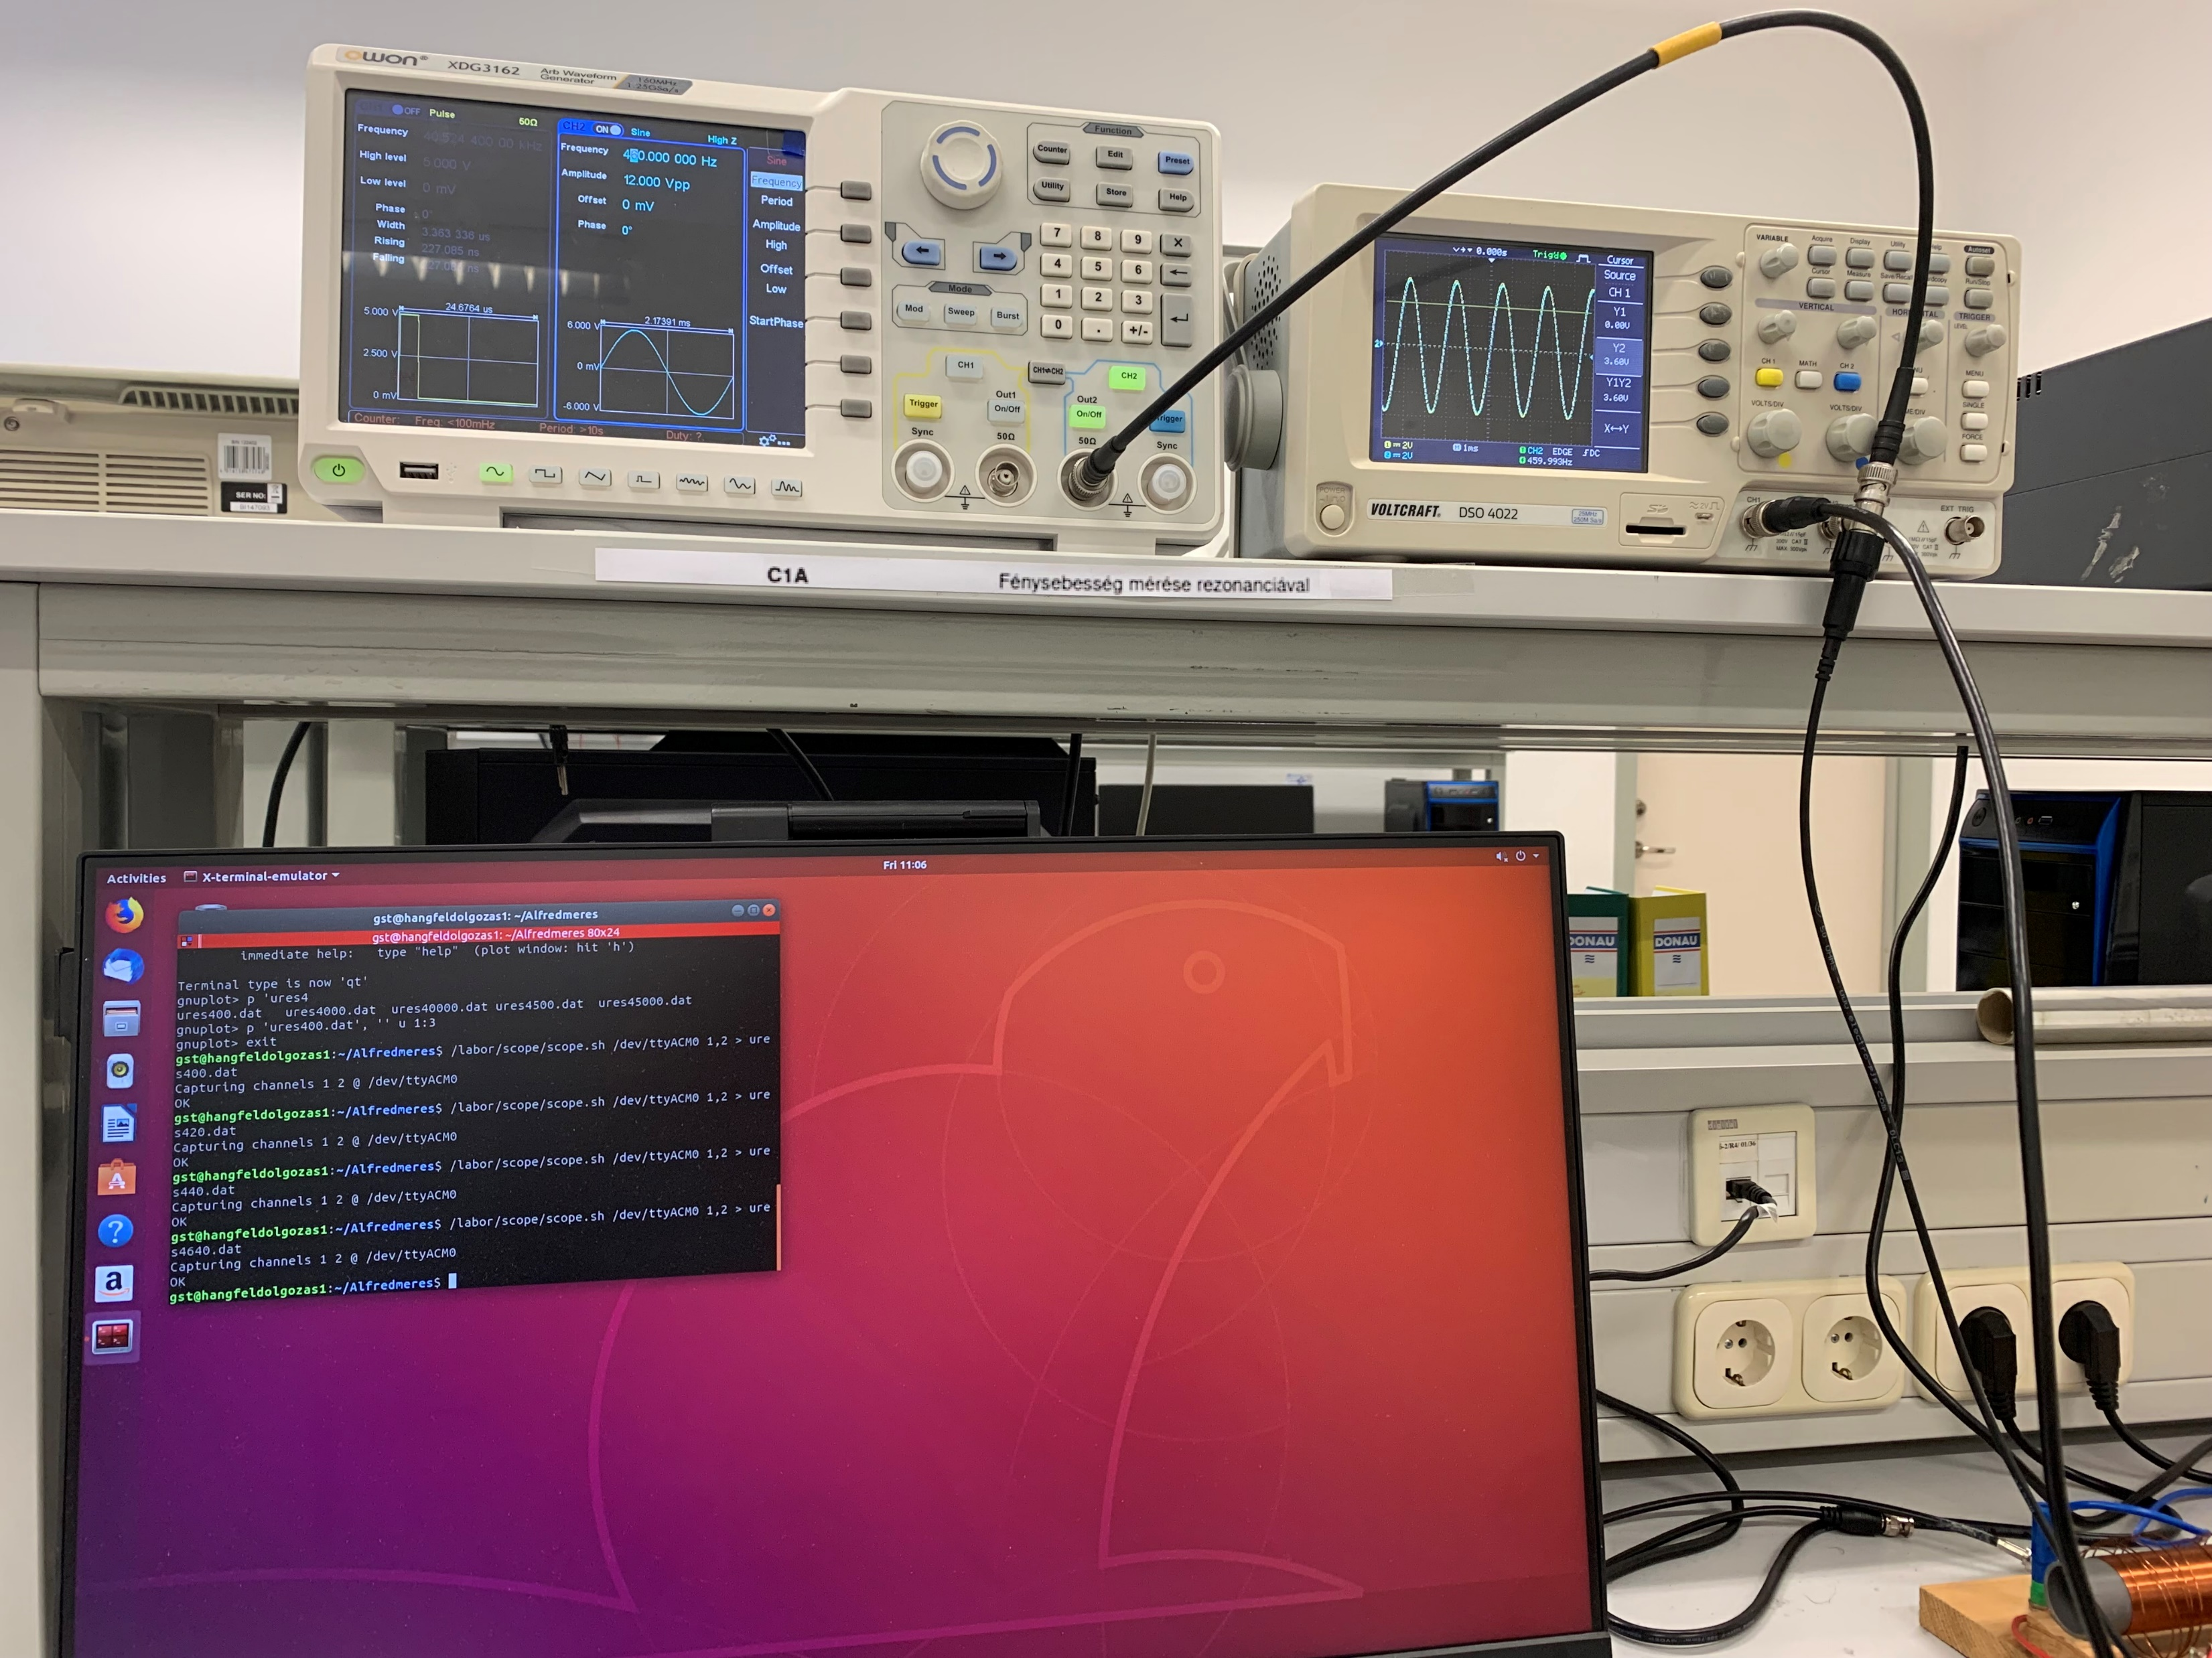
Instruments
XDG 3162 Function generator
DSO 4022 Oscilloscope

Slide 7
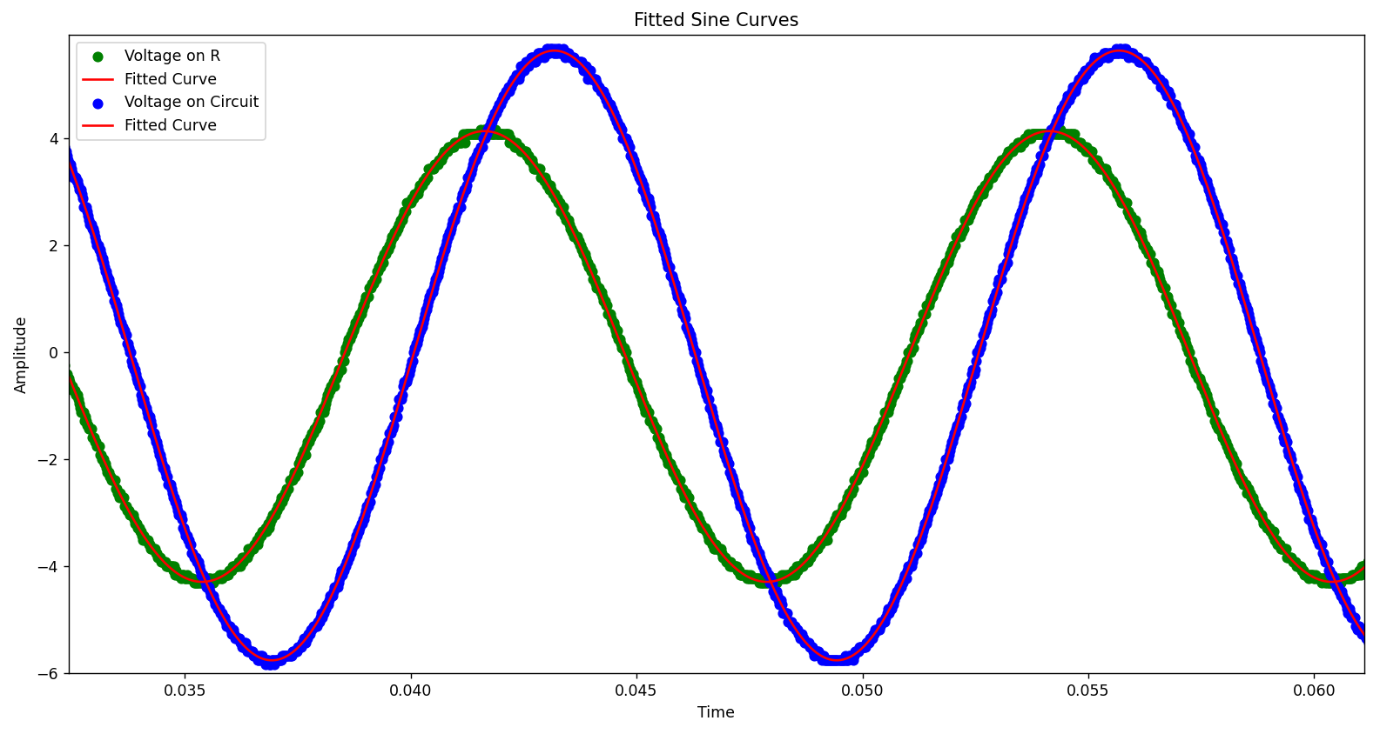
Measured sine waves
U_{T}^{max}
U_{R}^{max}
Phase

Slide 8
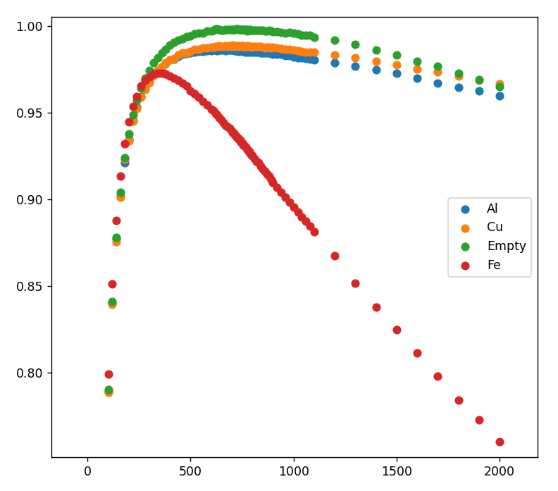
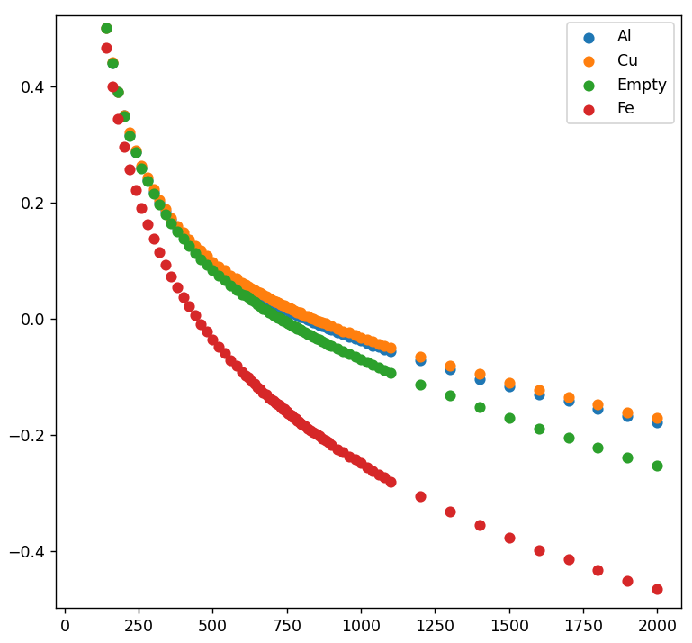
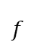
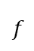
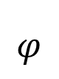
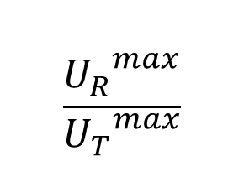
Parameters
$$\frac{{U_{R}}^{max}}{{U_{T}}^{max}}$$
$$φ$$
rad
$$f$$
$$f$$

Slide 9

Theory
Based on known theory for a serial LRC circuit in AC current:
$$\frac{{U_{R}}^{max}}{{U_{T}}^{max}}=\frac{R}{\sqrt{{\left(R+R_{L}\right)}^{2}+{\left(Lω−\frac{1}{Cω}\right)}^{2}}}$$
$$φ=arctan⁡\left(\frac{Lω−\frac{1}{Cω}}{R+R_{L}}\right)$$

Slide 10
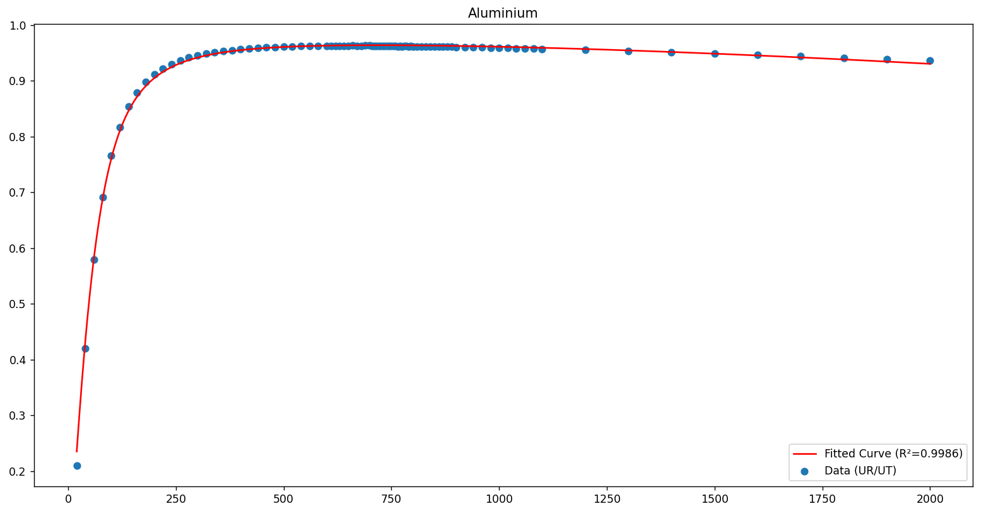
Based on voltage

Slide 11
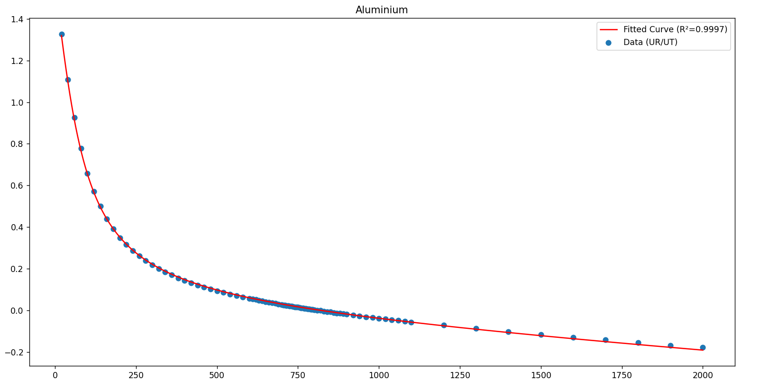
Based on phase

Slide 12
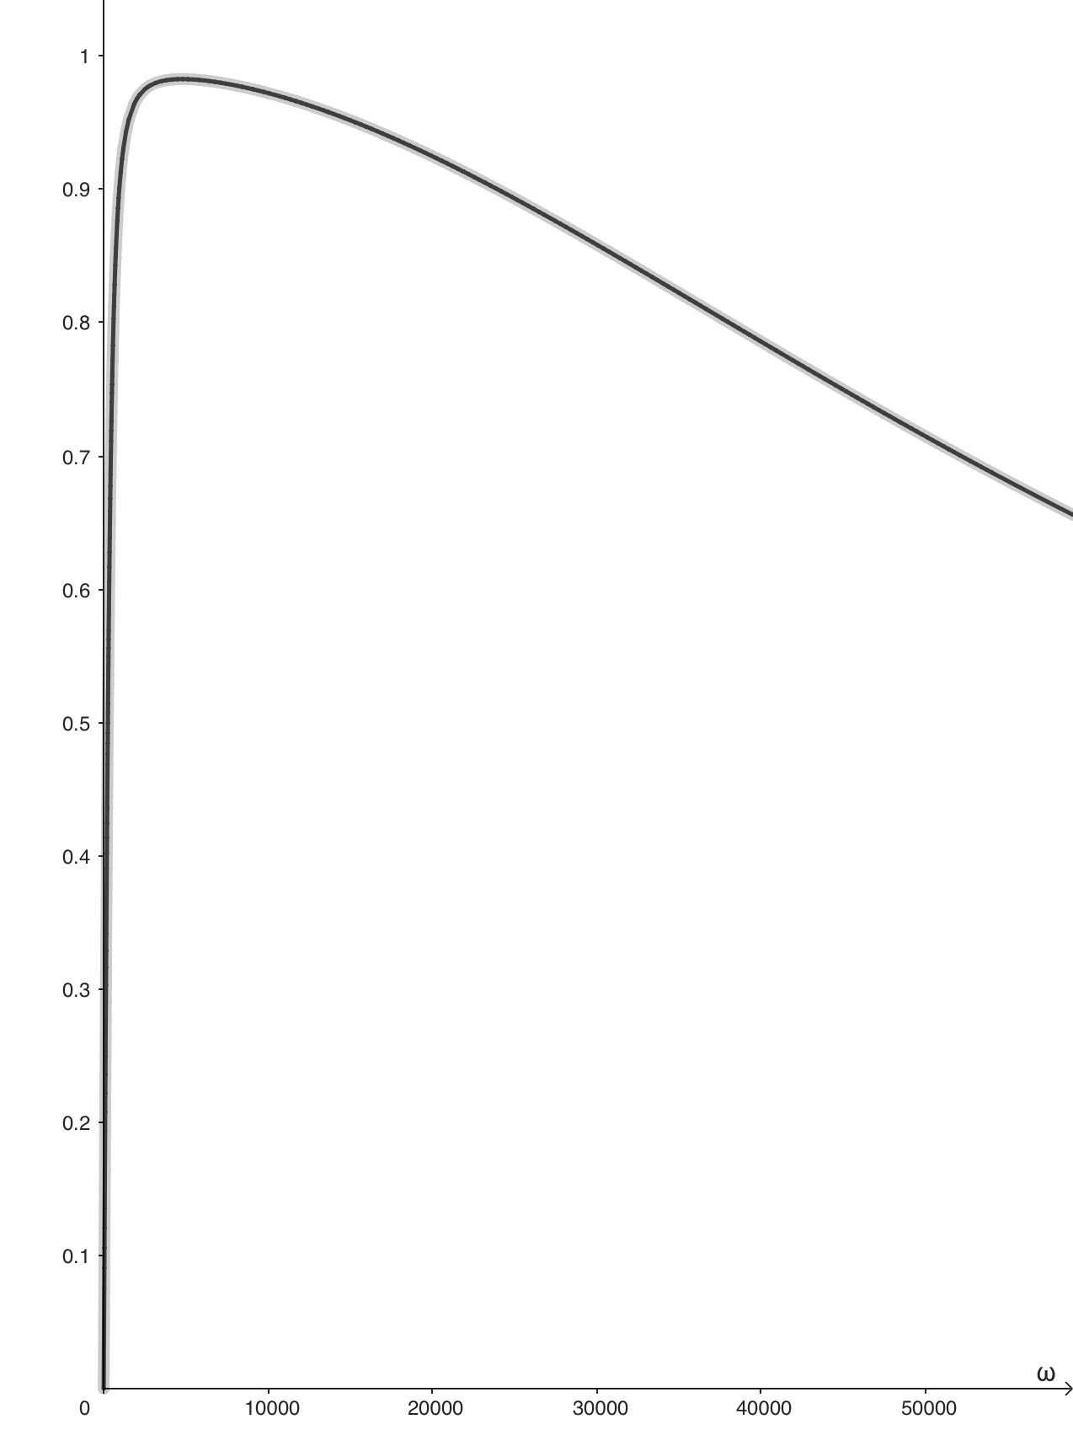
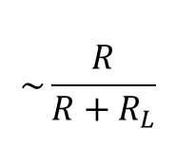



Results
$$\sim \frac{R}{R+R_{L}}$$
$$∆R_{L}$$
$$∆L$$
$$ω_{res}=\frac{1}{\sqrt{LC}}$$

Slide 13
How do the properties of the core influence L and R_{L}?

Slide 14
II. Skin effect

Slide 15
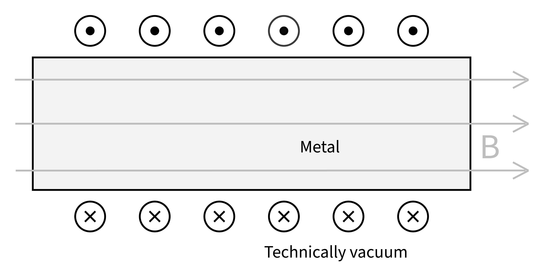

The coil
$$I=I_{0}\cos\left(ωt\right)$$
$$B= \frac{μ∗N∗I}{l}$$
$$Φ=Br^{2}π= \frac{μ∗N}{l}r^{2}π∗I$$

Slide 16
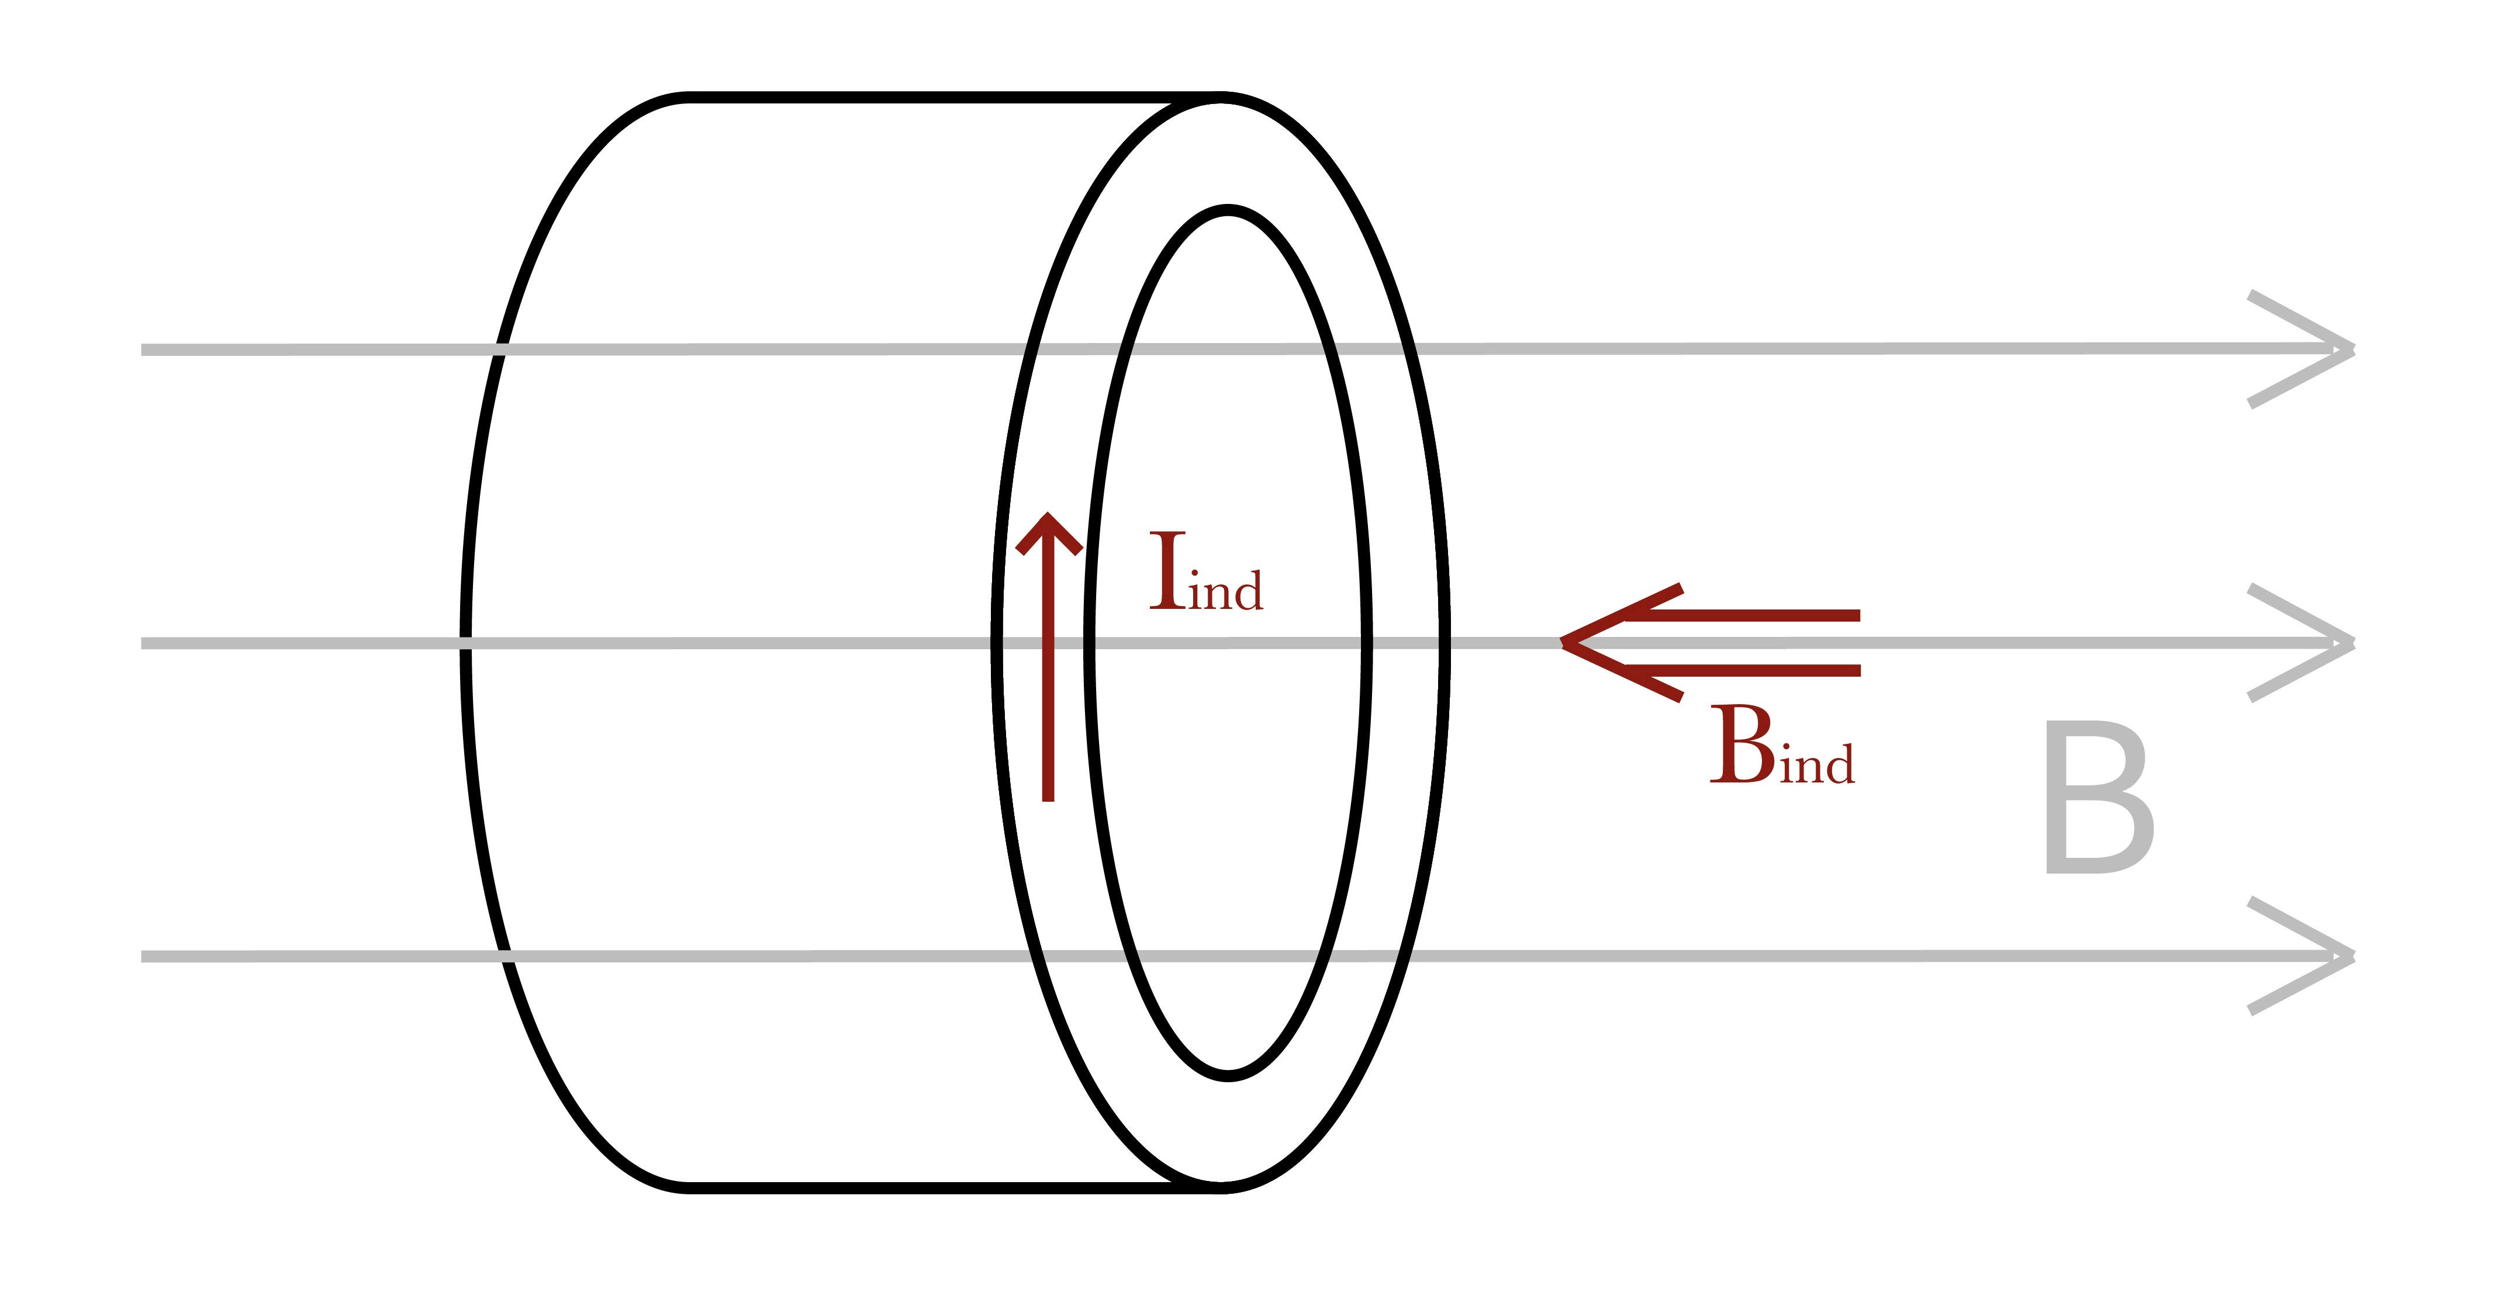
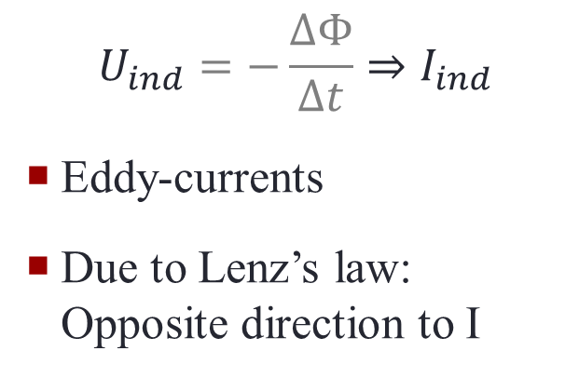
The core
$$U_{ind}=−\frac{∆Φ}{∆t}⇒I_{ind}$$
Eddy-currents
Due to Lenz’s law: Opposite direction to I

Slide 17
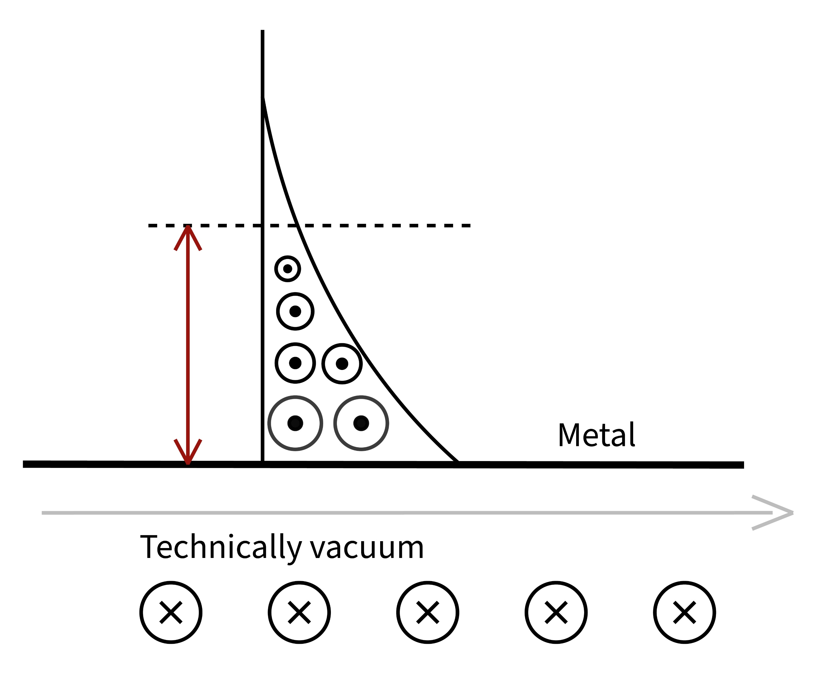
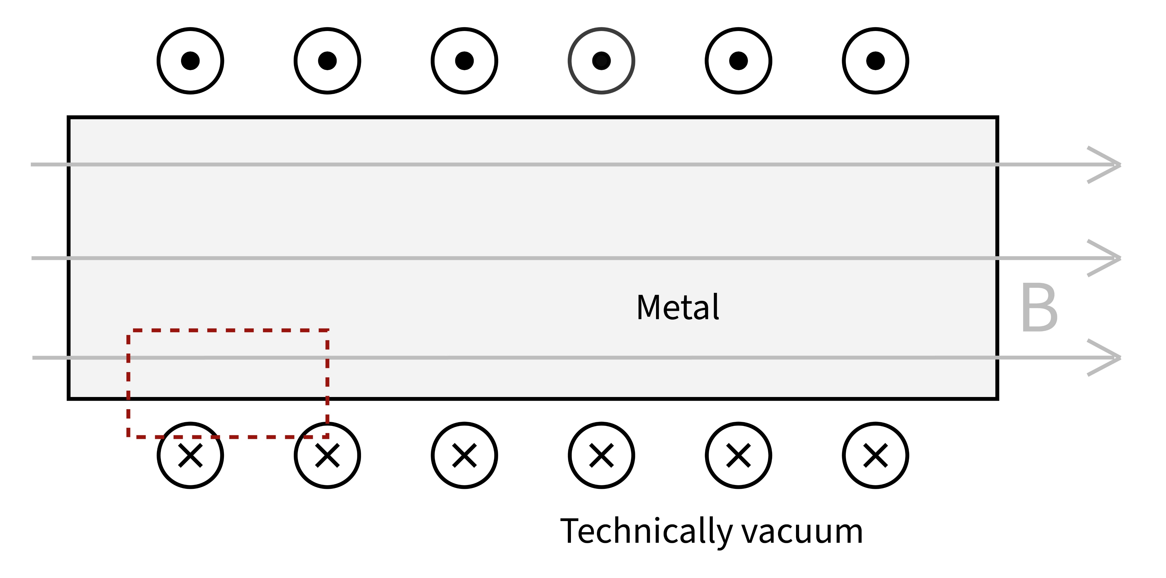
Skin effect
B and B_{EC} will cancel out
Less B towards center
At some point no more B
B = B₀cos(ωt)

Slide 18
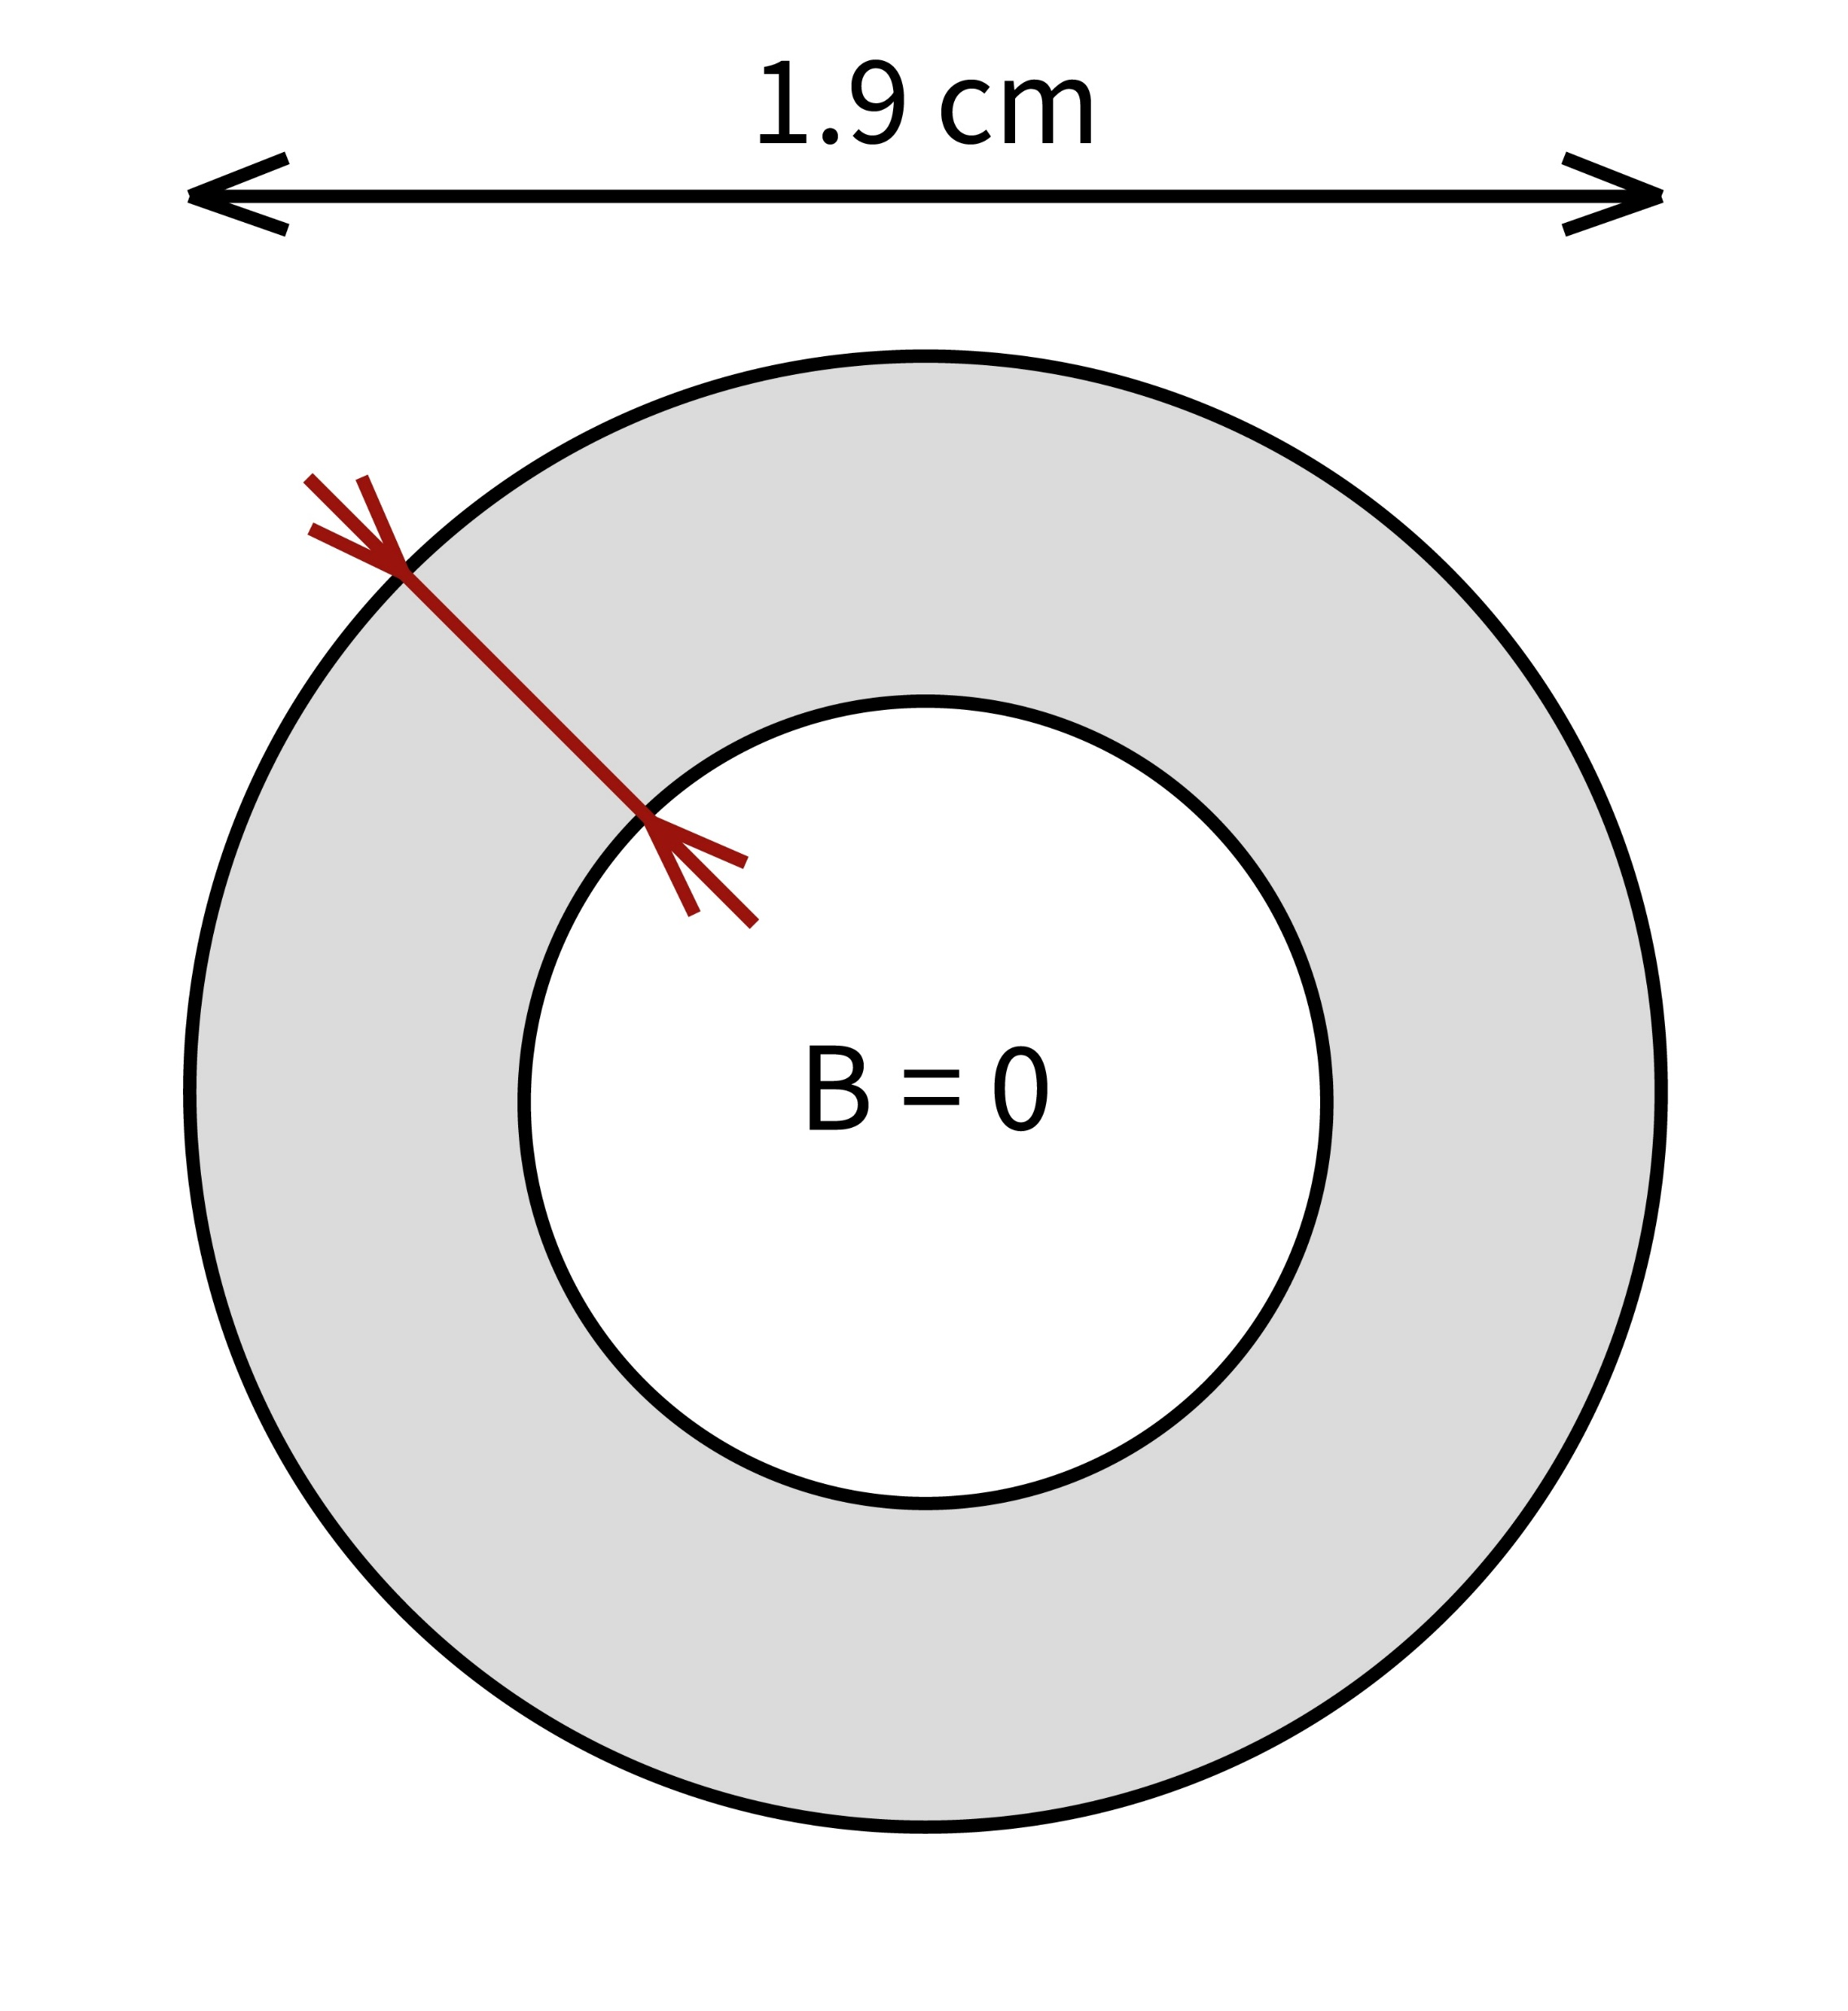



Skin-depth δ
How deep B penetrates the conductor
Technically $\frac{1}{e}≅37\%$ of $I_{ind}$ at the surface
Some point no current at all
$δ=\sqrt{\frac{2}{ωμσ}}=\sqrt{\frac{2ρ}{ωσ}}$
$$Φ=BA= \frac{μNI}{l}∗2rπ∗δ$$
δ
$$B=0$$
$$B≠0$$

Slide 19
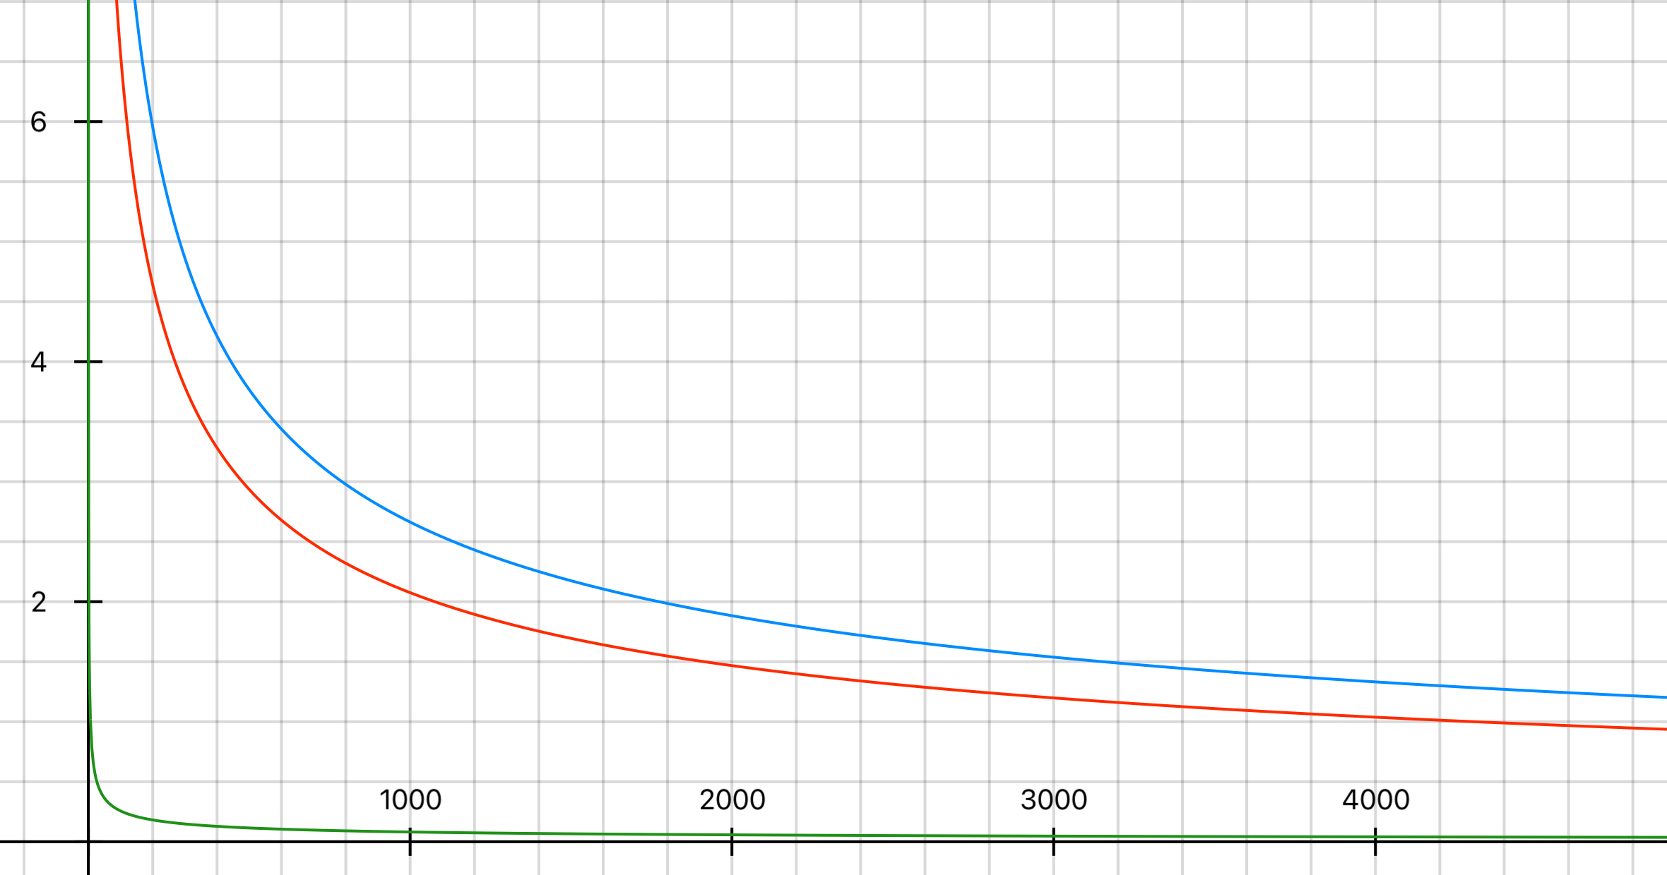
Skin-depth (example)
δ (mm)
Aluminium
Copper
Iron
f (Hz)

Slide 20
III. Inductivity L

Slide 21
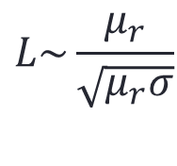

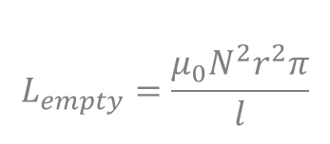
Effects
$$L_{empty}=\frac{μ_{0}N^{2}r^{2}π}{l}$$
$$N∗Φ=L ∗I$$
$$N∗\frac{μ_{0}μ_{r}NI}{l}∗2rπ∗δ=L∗I$$
$$L=\frac{μ_{0}μ_{r}N^{2}2rπ∗δ }{l}$$
$$L=L_{empty}∗\frac{2δ}{r}∗μ_{r}$$
$$L\sim \frac{μ_{r}}{\sqrt{μ_{r}σ}}$$

Slide 22
IV. Resistance R_{L}

Slide 23
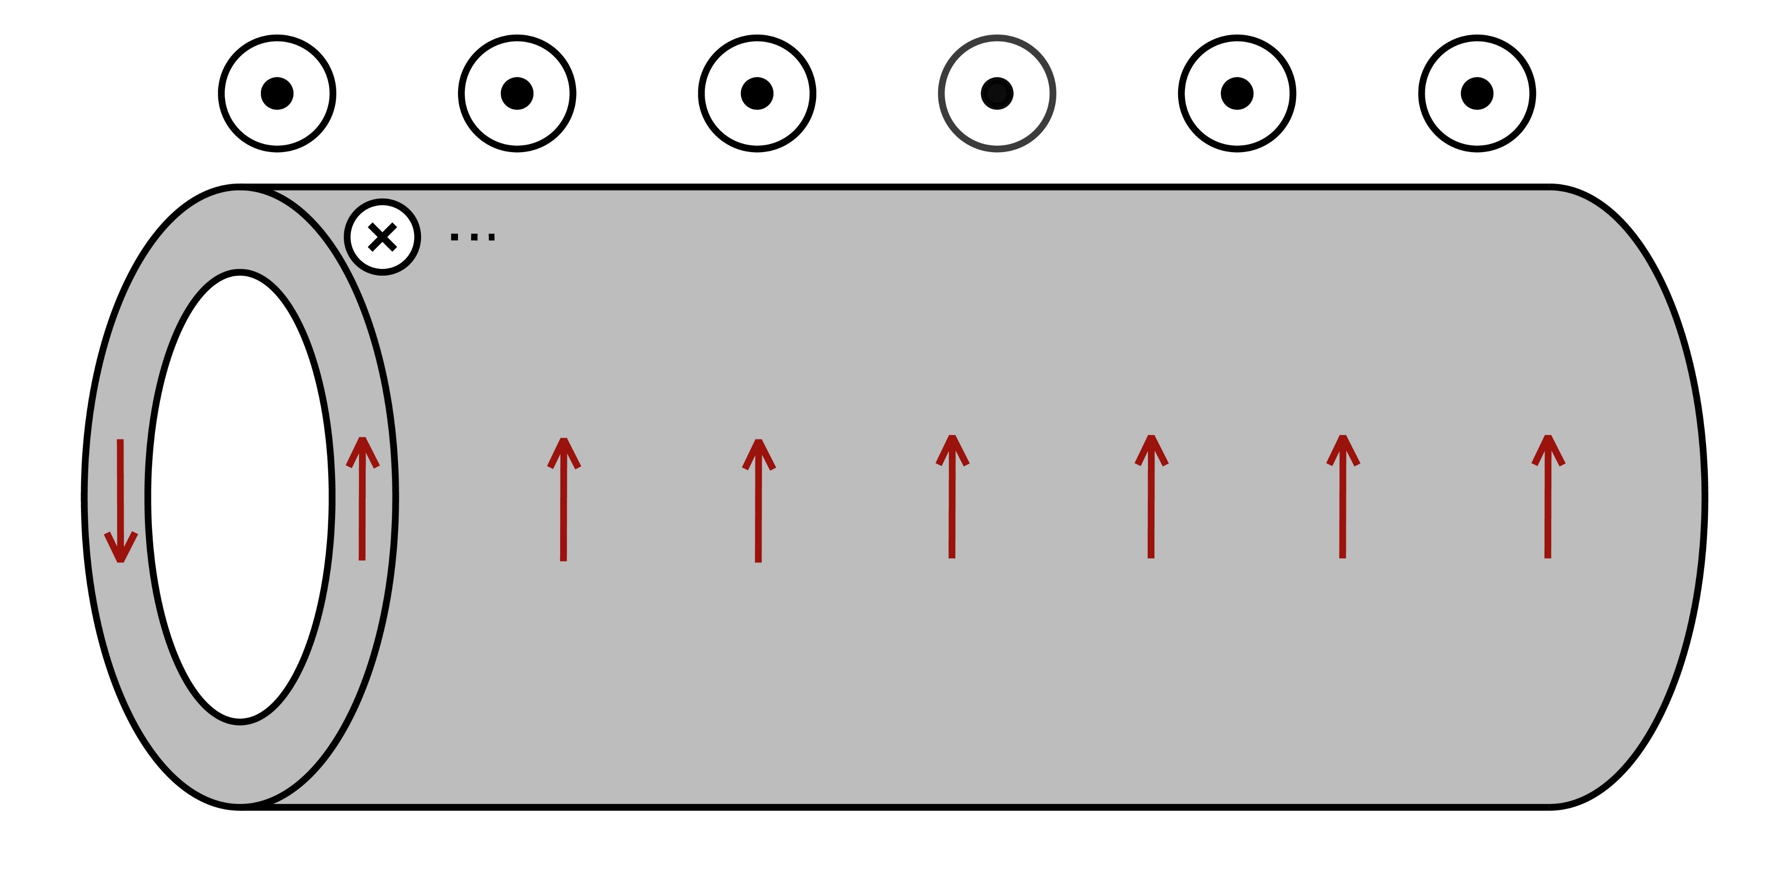
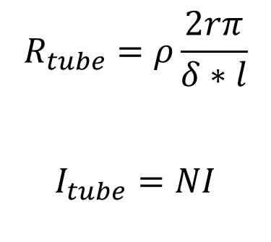

Phenomenon
I
$$R_{tube}=ρ\frac{2rπ}{δ∗l}$$
$$I_{tube}=NI$$
$$I_{tube}=N∗I$$

Slide 24
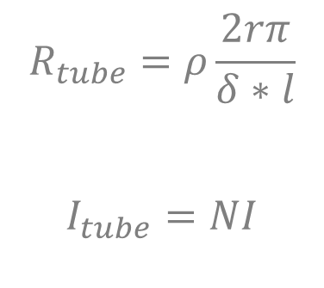
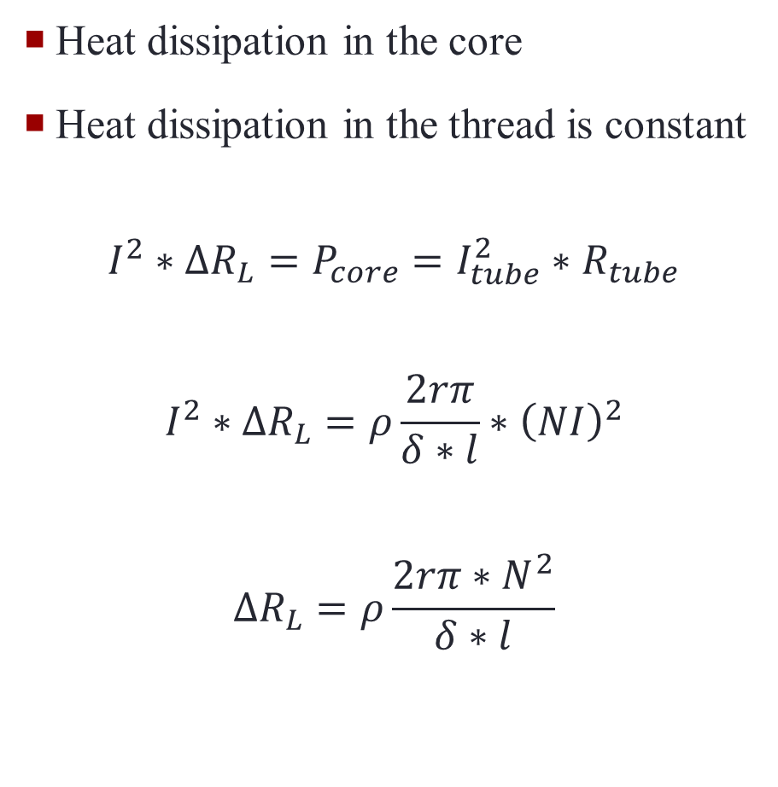
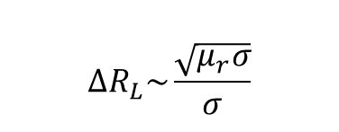
Effects
Heat dissipation in the core
Heat dissipation in the thread is constant
$$I^{2}∗∆R_{L}=P_{core}=I_{tube}^{2}∗R_{tube}$$
$$I^{2}∗∆R_{L}=ρ\frac{2rπ}{δ∗l}∗{\left(NI\right)}^{2}$$
$$∆R_{L}=ρ\frac{2rπ∗N^{2}}{δ∗l}$$
$$R_{tube}=ρ\frac{2rπ}{δ∗l}$$
$$I_{tube}=NI$$
$$∆R_{L}\sim \frac{\sqrt{μ_{r}σ}}{σ}$$

Slide 25
„How can we obtain the magnetic and electric properties of the inserted rod from the circuit’s responses?”

Slide 26
V. Summary

Slide 27
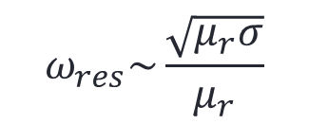
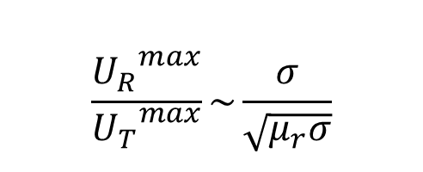


Summary
Procedure:
Measure both peak voltages and the phase
Calculate L and R_{L} through curve fitting
Solve the resulting equation system
$$ω_{res}\sim \frac{\sqrt{μ_{r}σ}}{μ_{r}}$$
$$\frac{{U_{R}}^{max}}{{U_{T}}^{max}}\sim \frac{σ}{\sqrt{μ_{r}σ}}$$
$$∆R_{L}=ρ\frac{2rπ∗N^{2}}{δ∗l}$$
$$L=L_{empty}∗\frac{2δ}{r}∗μ_{r}$$

Slide 28
Thank you!

